Slide 1


2023 information session for
Parents and Caregivers

Slide 2

Acknowledgement of Country
We acknowledge the Kaurna people of the Adelaide Plains as the custodians of the land on which our school stands, and our feet are firmly planted.
We pay our respect to the Kaurna elders past, present, and emerging.
We understand that this land is sacred, and we respect and value the Kaurna People’s connection to this land.
We also extend our respect to other Aboriginal Language Groups and First Nation people.
Notes:
Two Years ago began the process of developing our new strategic plan. As part of the process we engaged an external company to work with our families, students and staff to gather their thoughts. From here our leadership team them worked with our Board, P & F, students and staff to finalise our new strategic plan which we will share with you throughout 2023. This exciting work led us to reimaging our Vision, School Values and Learner Dispositions so that they reflected the type of community St Joseph's aspires to be. Over the last two weeks we have been introducing our Values and Dispositions and tonight we would like to introduce these to our families as well.

Slide 3

Prayer
Heavenly Father,
we gather here tonight as parents and staff of this community, to seek your guidance and blessings as we embark on a new school year.
Grant us the wisdom and patience to effectively communicate and collaborate in shaping the minds and hearts of our children. May we be diligent in our efforts to provide a safe and nurturing environment where they can flourish academically, socially, and spiritually.
We ask that you bless each and every student in this school with the gift of Persistence, Resilience, Collaboration, Curiosity and Bravery and help them to grow in their faith and love for you. May they be respectful and compassionate towards others and positively influence their homes, school, and community.
We ask for your protection and guidance as we embark on this new school year. May we work together in unity and peace, to build a better future for our children and our world.
We make this prayer through Jesus Christ our Lord, who lives and reigns with you and the Holy Spirit, one God, forever and ever.
Amen.
Notes:
Two Years ago began the process of developing our new strategic plan. As part of the process we engaged an external company to work with our families, students and staff to gather their thoughts. From here our leadership team them worked with our Board, P & F, students and staff to finalise our new strategic plan which we will share with you throughout 2023. This exciting work led us to reimaging our Vision, School Values and Learner Dispositions so that they reflected the type of community St Joseph's aspires to be. Over the last two weeks we have been introducing our Values and Dispositions and tonight we would like to introduce these to our families as well.

Slide 4
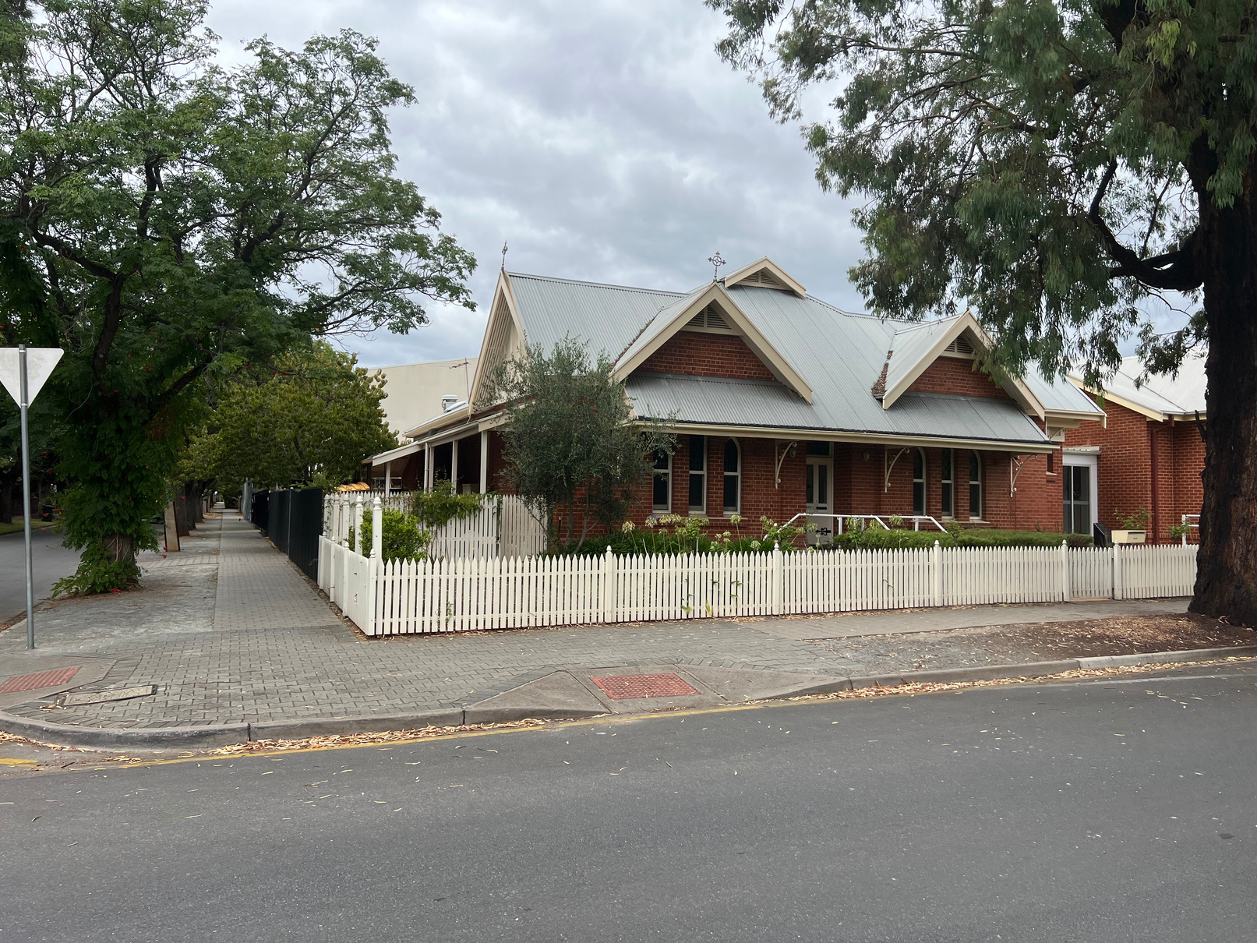
Our Journey
Two Years ago began the process of developing our new strategic plan.
We engaged an external company to work with our families, students and staff to gather their thoughts.
Reimagined our Vision, School Values and Learner Dispositions so they reflect the type of community St Joseph's Kingswood aspires to be.
Notes:
Two Years ago began the process of developing our new strategic plan. As part of the process we engaged an external company to work with our families, students and staff to gather their thoughts. From here our leadership team them worked with our Board, P & F, students and staff to finalise our new strategic plan which we will share with you throughout 2023. This exciting work led us to reimaging our Vision, School Values and Learner Dispositions so that they reflected the type of community St Joseph's aspires to be. Over the last two weeks we have been introducing our Values and Dispositions and tonight we would like to introduce these to our families as well.

Slide 5
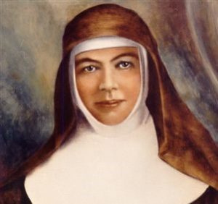
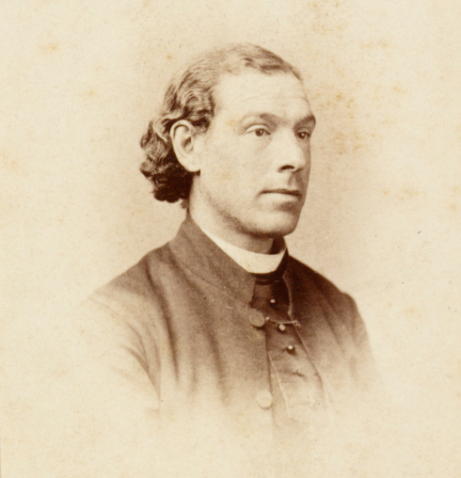
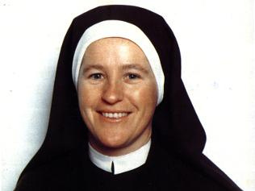
Our Values
Saint Mary MacKillop
Father Julian Tenison Woods
Sister Irene McCormick
EXCELLENCE
CONNECTION
GRATITUDE
Notes:
Our three values Excellence, Connection, and Gratitude not only reflect the values our community wish to instill in the students of St Joseph's but they also reflect the values our 3 patrons displayed throughout their life. You will notice that each Patron has a coloured ring around their photo this is because our house teams are also named after our patrons. Blue is MacKillop, Yellow is Tenison, and Red, McCormick

Slide 6
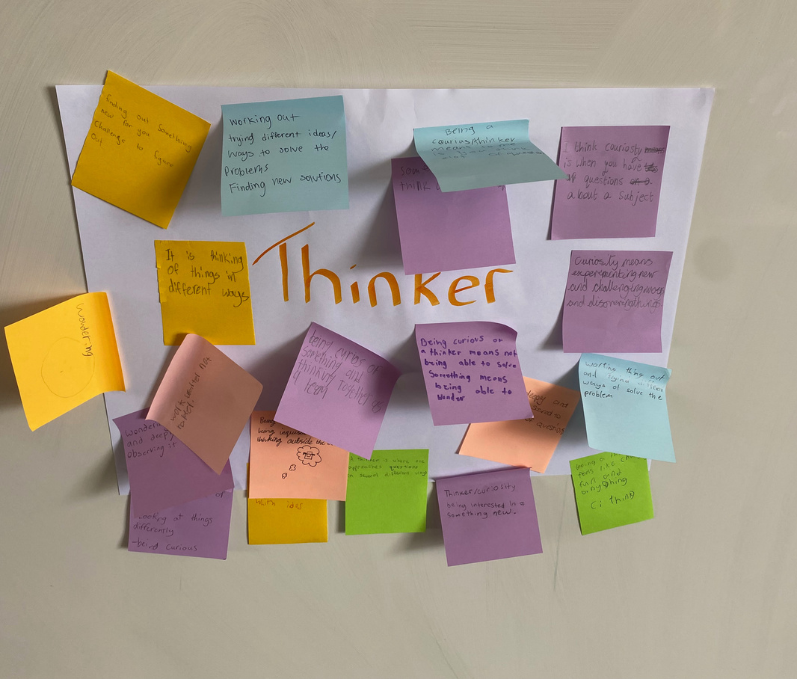

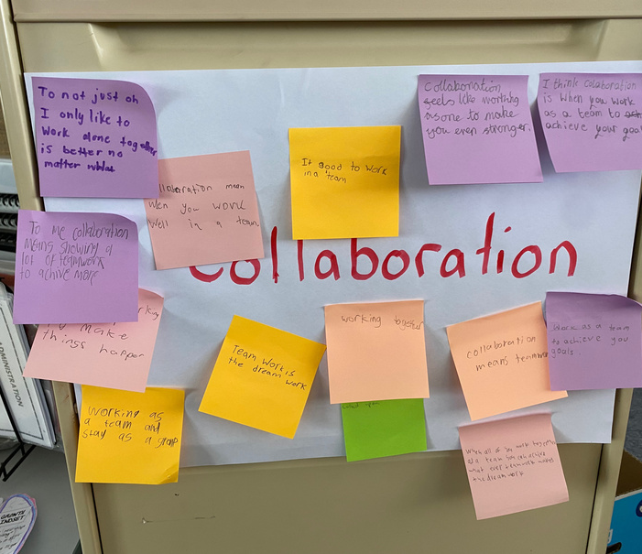
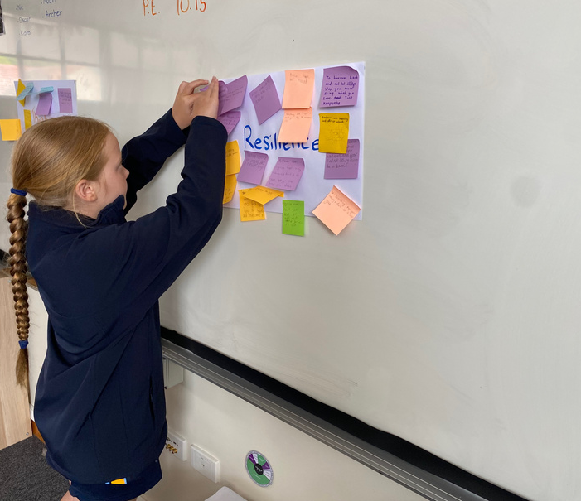
Learner Dispositions
BRAVERY
RESILIENCE
PERSISTENCE
COLLABORATION
CURIOSITY/
THINKER
Notes:
We have five Learner Dispositions Bravery, Resilience, Thinker/ curious, Persistence, and Collaboration.
Learner Dispositions can be explained as the characteristics or attitudes students use in their approach to learning. They are life skills, and when explicitly taught to students they become the habits of mind they will use to repond to situations now and in the future.

Slide 7
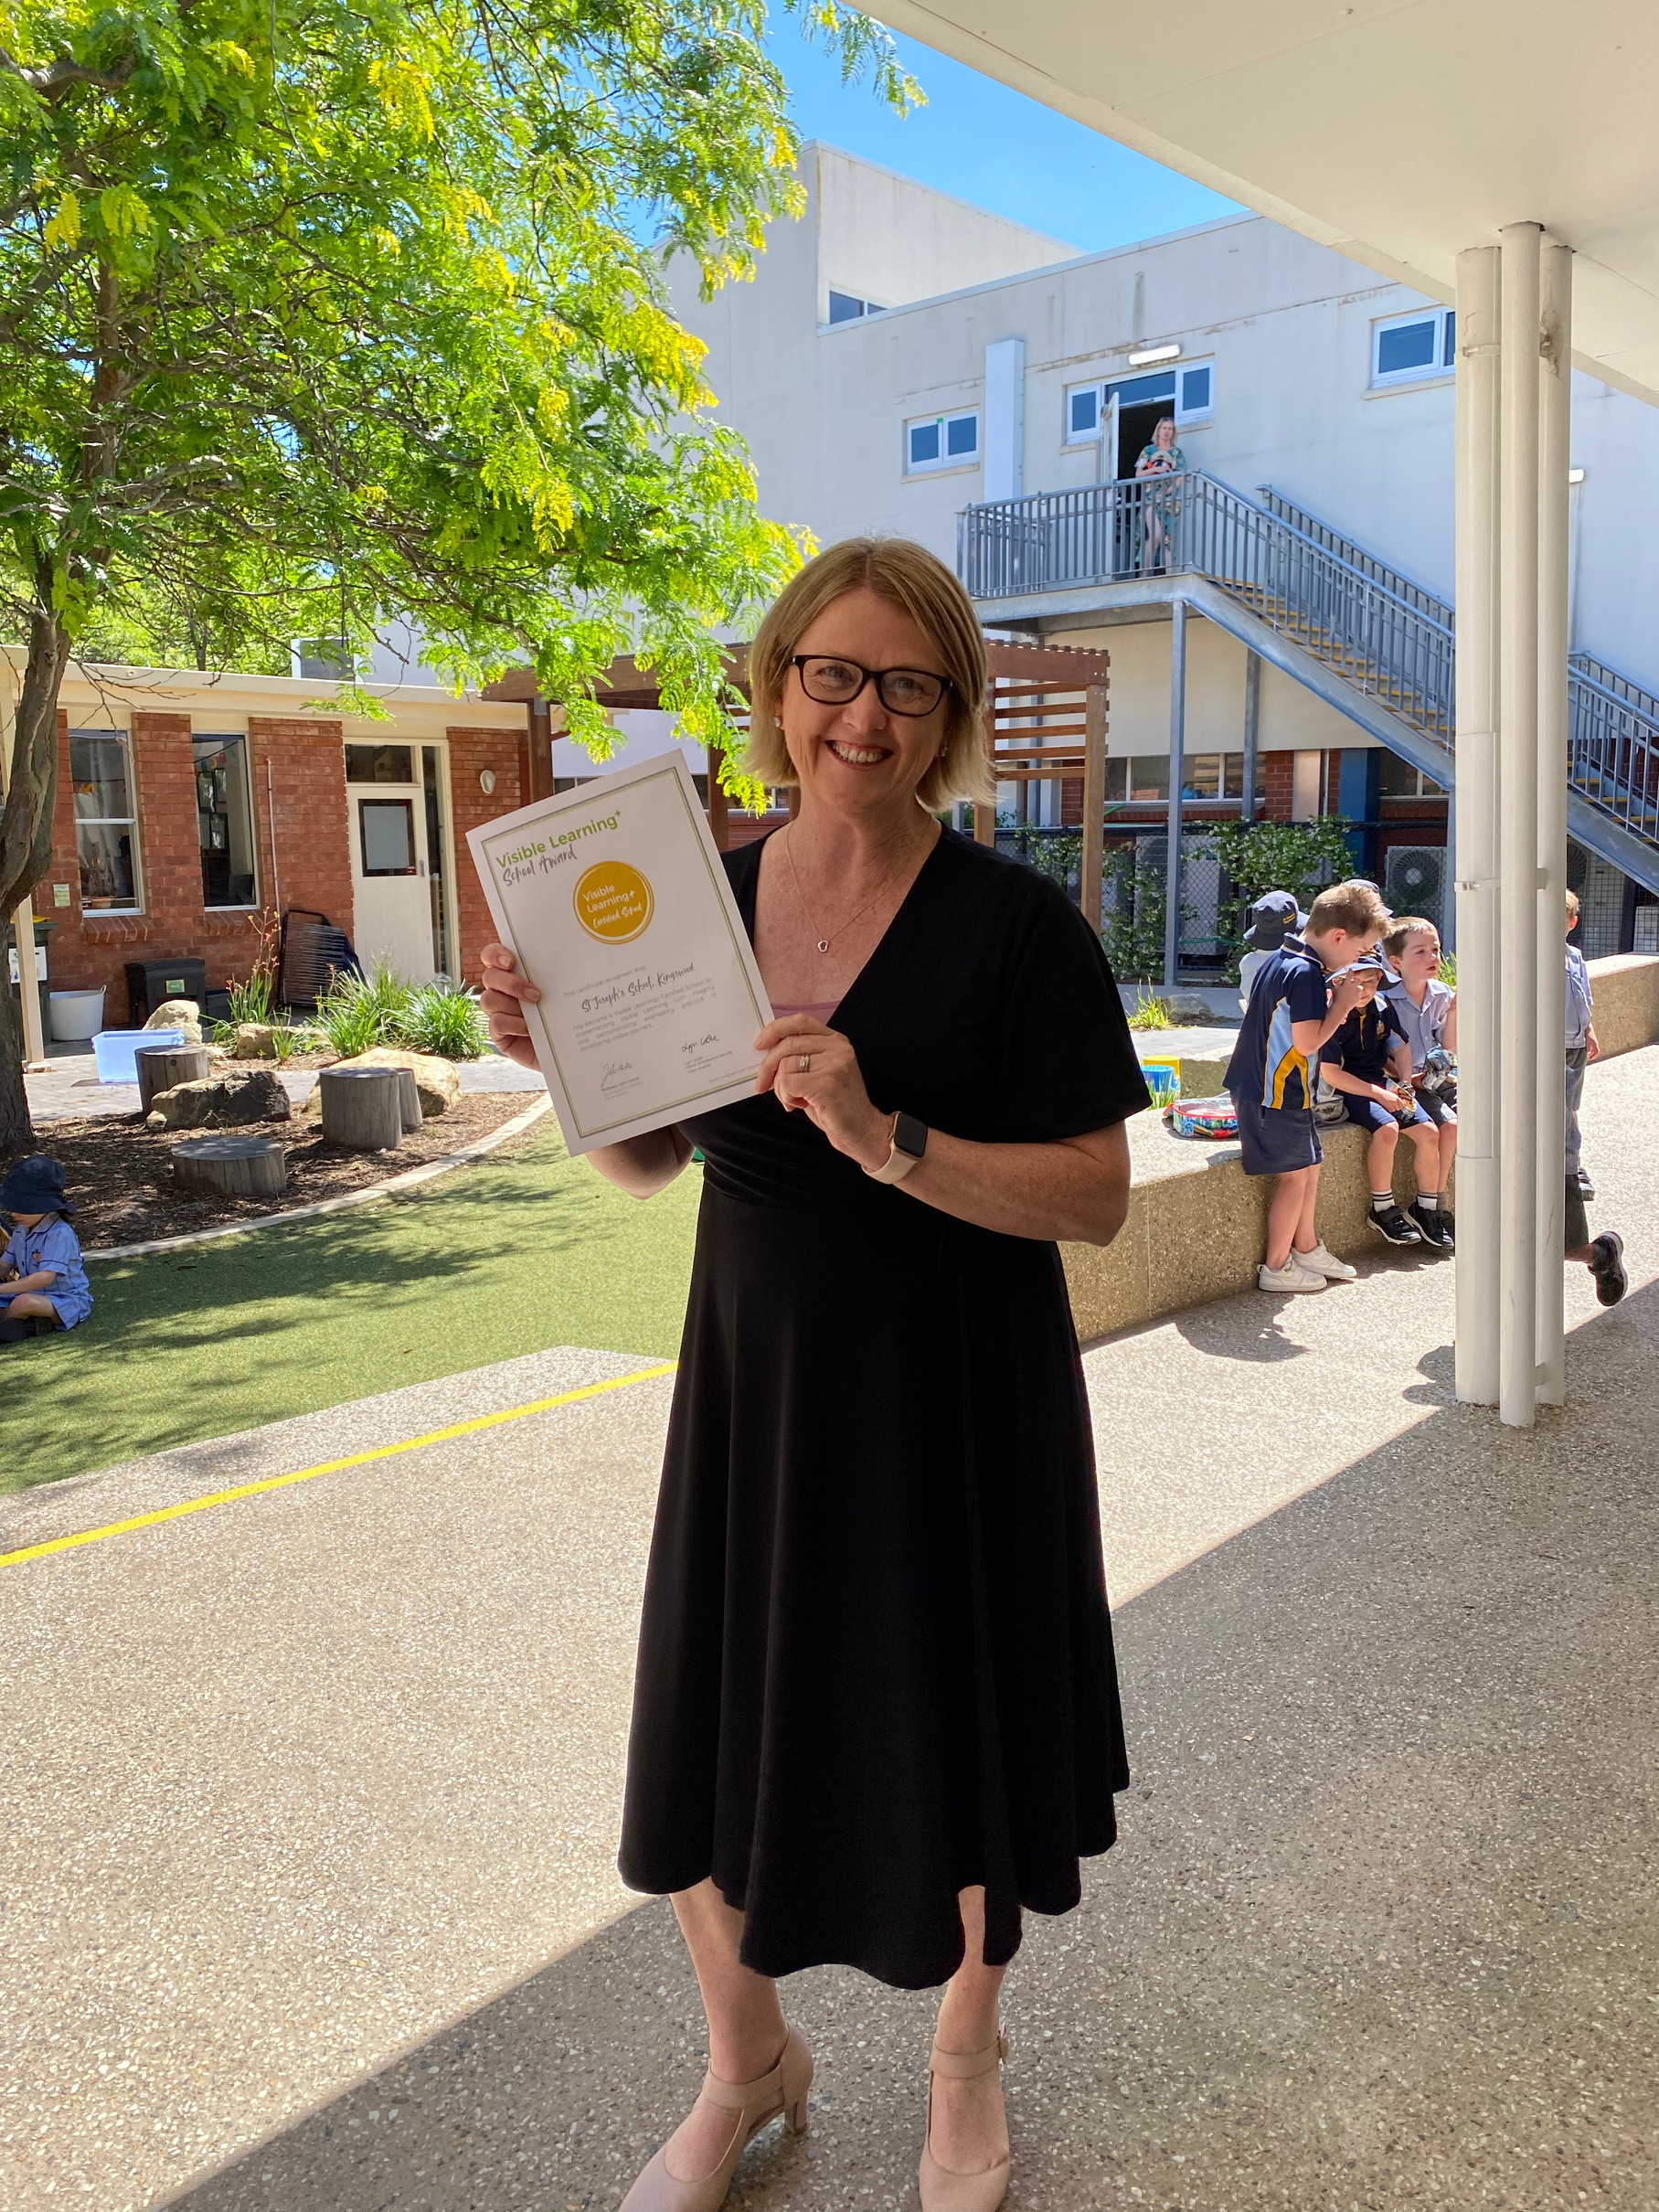

Visible Learning
St Joseph's, Kingswood is the first South Australian school and 1 of 12 schools globally to be awarded Visible Learning Certification.
This means that the teachers at St Joseph's, Kingswood focus on and implement strategies that have the biggest
impact on student progress.
Our priority is on what works
best for learning.
Notes:
The different approaches taken with designing learning tasks, assessments, and teaching are not haphazard. Our Visible Learning Certification was awarded to us because all our approaches to learning are grounded in research and reflect best practices. Our teaching is informed by data and the decisions we make are intentional.

Slide 8
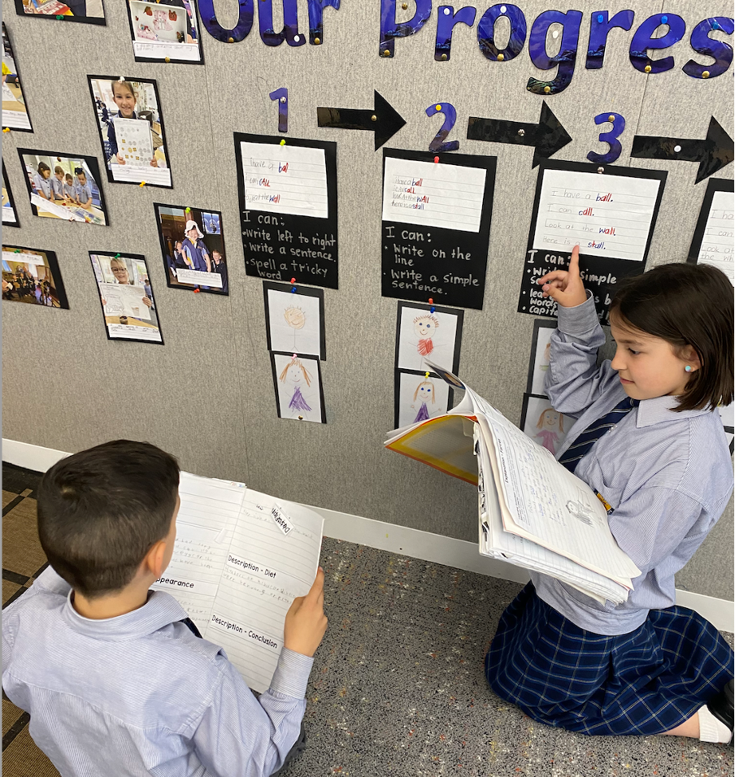
Visible Learning
in the Classroom
  Learning Intentions
  Success Criteria
  Progress Walls
  Learning tasks that allow for surface and deep Learning as well as the transfer of knowledge
  Learning Pit & Growth Mindset
  Student agency
  Regular use of data
Notes:
In the classroom here are some of the tools that we use that reflect John Hattie's research and positively impact the progress children make.

Slide 9
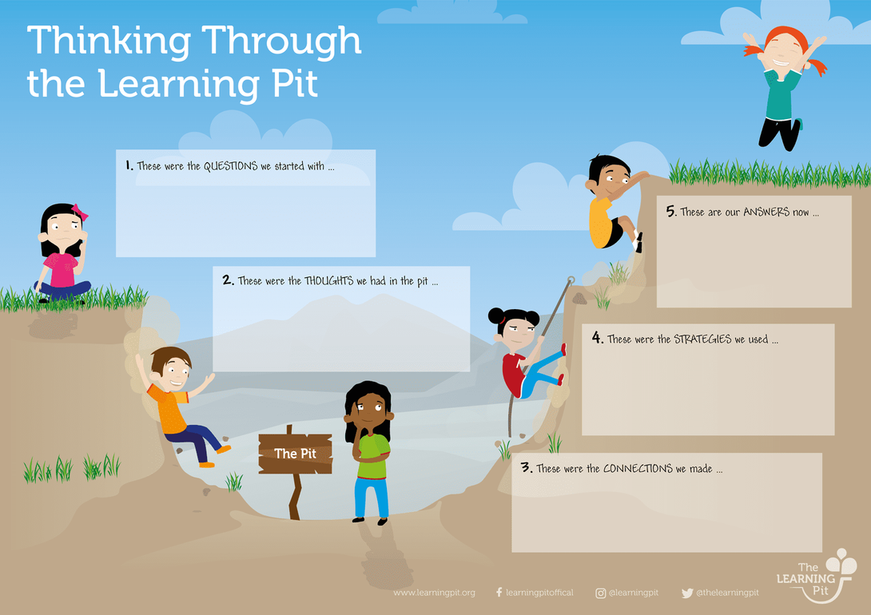
Learning Pit
Going into the Pit
  Seeking Challenges
  Stepping out of your comfort zone
  Experimenting
  Questioning
  Looking for Alternatives
Climbing out of the Pit
  Finding Solutions
  Creating meaning
  Gaining Clarity
  Harmonising
  Grasping
Notes:
The Learning Pit is one way to explain why challenge leads to enhanced learning. It helps teachers structure lessons, and encourages students to challenge themselves. Designed by James Nottingham the Learning Pit invites children to take risks and step out of their comfort zone. It encourages the students to identify strategies they can use to assist them with their learning. This is a tool that is used as a pathway to excellence.

Slide 10
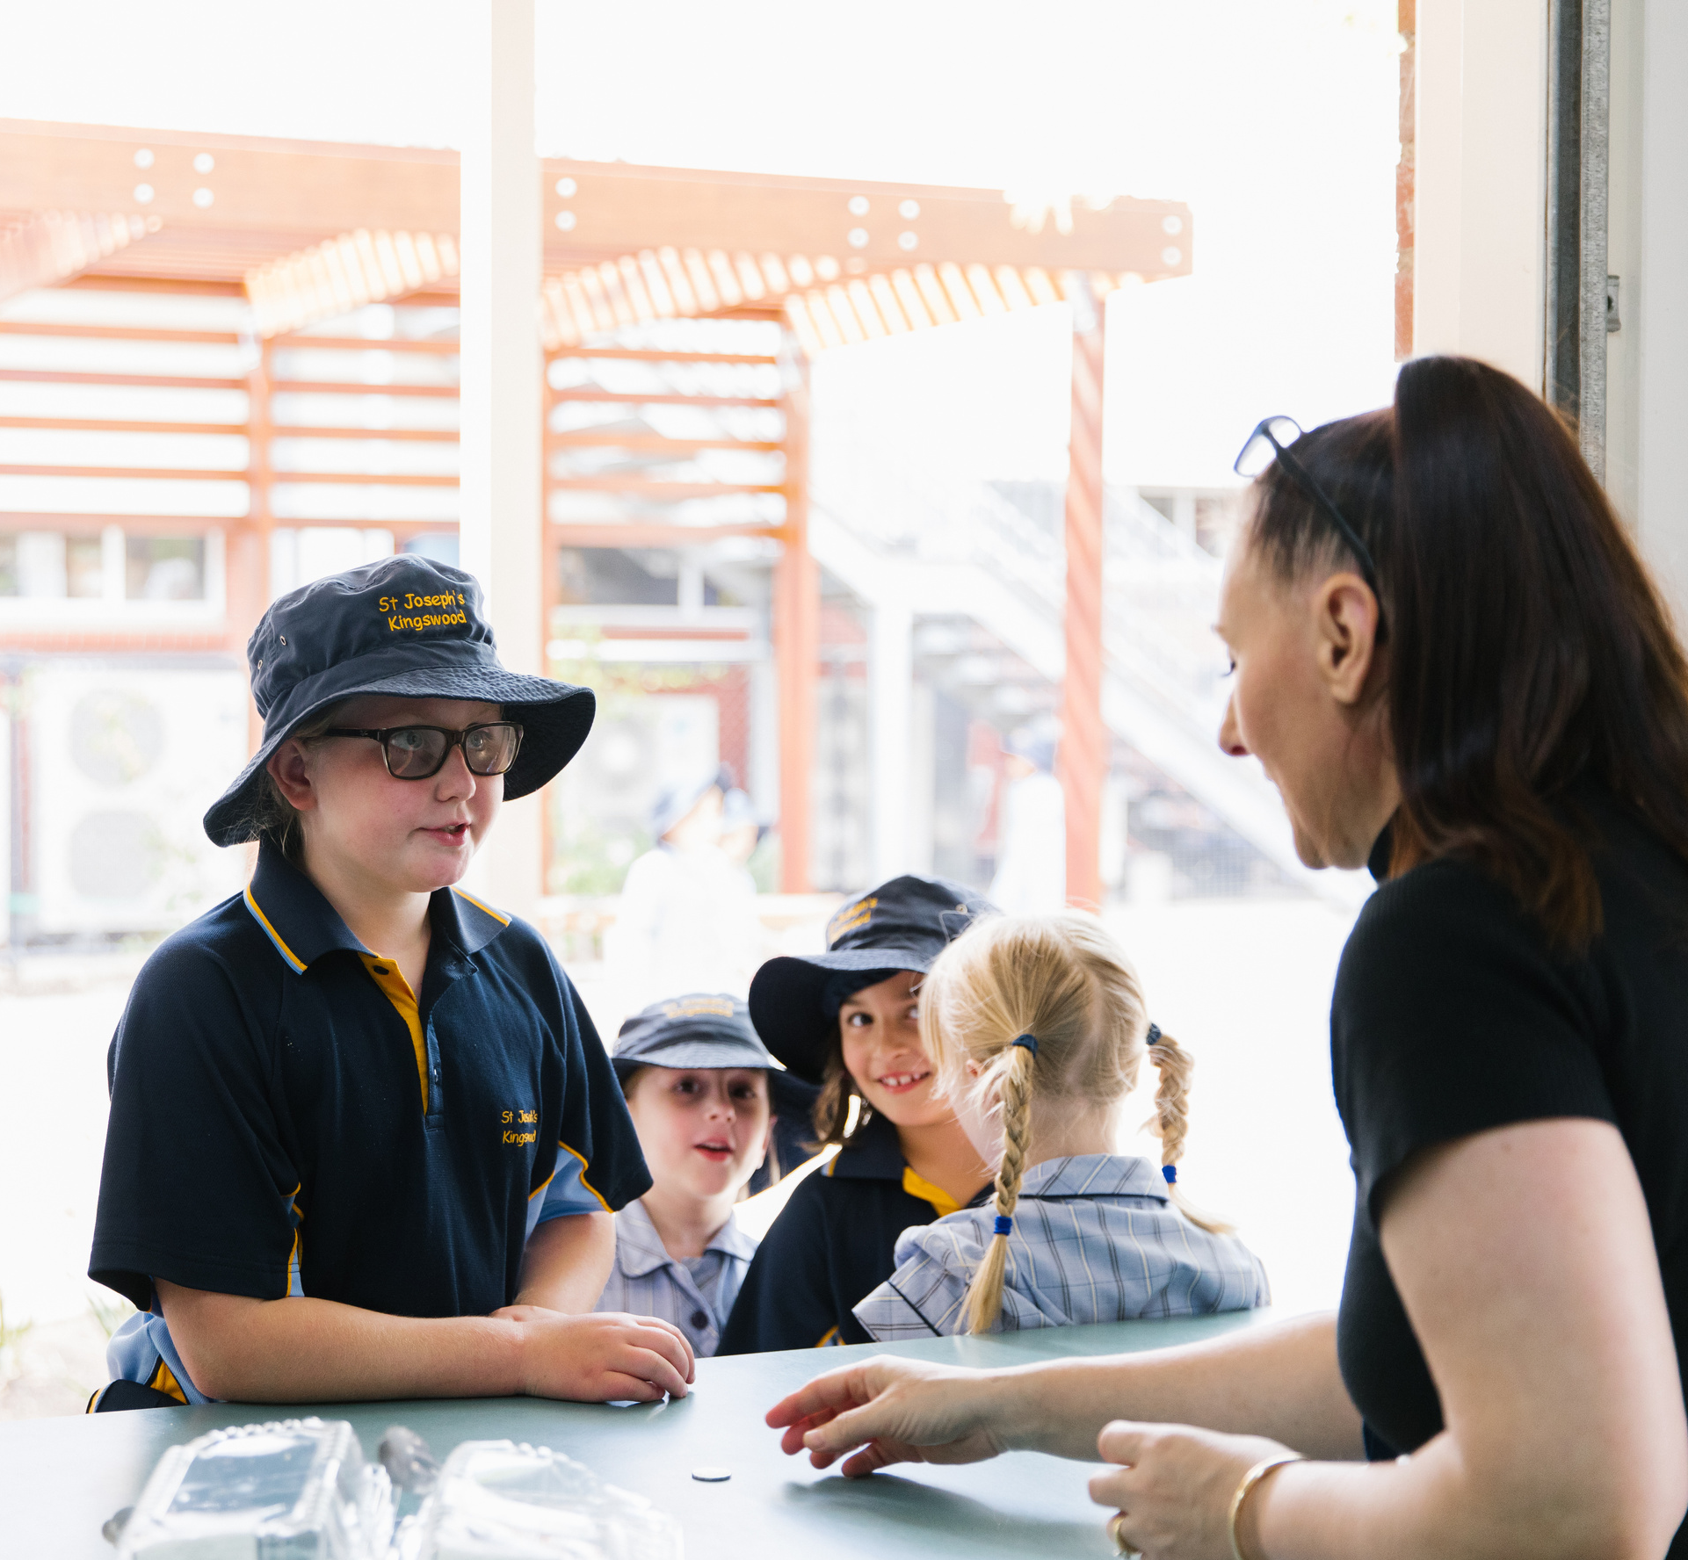
Developing Personal
Responsibility
  Morning Welcome
  Circle Time
  Class Agreements
  Affirmative statements
  Restorative conversations
Notes:
We use a range of strategies to support students to take responsibility for their actions both positive and negative and we do this through a range of different whole-school approaches. We will now demonstrate a morning welcome with you. Typically we would do this in a circle so every child feels included.
Morning welcome (Daily) = The first consistent, predictable routine of the day that creates a sense of safety and belonging. It can also be the first positive interaction a child can have for the day.
The morning welcome follows a structure of a:
Positive interaction- Can be a child’s first positive interaction of the day. Using name makes them feel welcome and valued. Demonstrating that you can have safe touch between people. So we ask you to introduce yourself to the people next to you.
Values and Expectations- Set the expectations for the days and select 3 values to anchor to and reflect on during the day/week. What are three values we can focus on tonight?
Track the speaker: A gentle reminder to students to keep eyes on the person speaking and show active listening skills- respect
Announcements: Anything interesting to share? Birthdays, celebrations etc
Does anyone have any announcements they would like to share. (If no one shares - teachers share their own announcements.)
Positive Primer: A short, easy and fun activity or game to bring some smiles into the room.
What Went Well?: Reflection of What went well during the morning. Done again at the end of the day

Slide 11
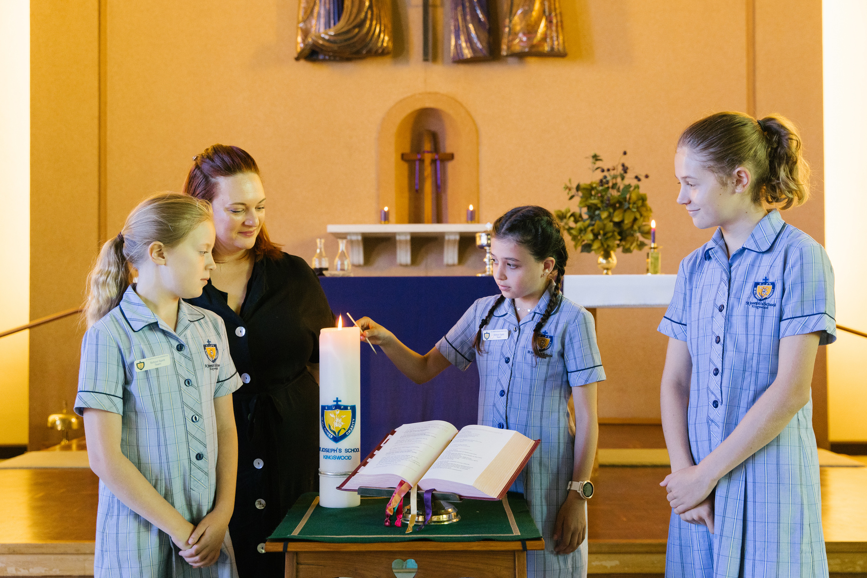
Sacramental Program
•Runs from March to November
•Across three schools: St Joseph’s, St Therese (Coronel Light Gardens), St Thomas (Goodwood)
•Reconciliation à Confirmation à Communion
•Parish Run and School Supported
•Format: Workshops, Digital Content, Workbooks.
•We recommend starting the program between ages 8 to 10 (Year 3 to Year 5) however this is a decision to be made within the child’s family.
•
•2023 program is about to commence. Please contact sacraments@eparish.org.au to enroll. The program brochure and 2023 enrollment form are available from the school’s front office.
•Contact our APRIM, Christine Farrugia at cfarrugia@stjk.catholic.edu.au for more information.
Notes:
We offer a sacramental program here at St Joseph's and this is run through our parish. We offer Reconciliation, Communion, and Confirmation. We still have availability in our program this year, please contact Christine if you would like to enrol your child.

Slide 12

Child Protection Curriculum
  The Right To be Safe
  Relations
  Recognising and Reporting abuse
  Protective Strategies
Climbing out of the Pit
Notes:
As part of our Health curriculum we teach the child Protection Curriculum and each term there is a different focus area. They are: The Right To be Safe, Relations, Recognising and Reporting Abuse and Protective Strategies.

Slide 13

Promoting Reading
  We visit the school library week
  Mitcham Library
  Daily Independent reading - children encouraged to bring books from home
  Teachers read to students
  Buddies
  Big Books
  eBooks
  Class novels
Notes:
At St Joseph's we promote reading in a number of ways because it is so important to devlop that love of reading alongside learning the skills to decode. (Play Video)

Slide 14

Literacy Pro
  Literacy Pro is powered by The Lexile Framework®. It measures student reading ability and text complexity on the same scale.
  Match students to good fit books based on their interest and Lexile.
  Monitor students reading progress and set achievement goals. Promote discussions between student and teacher focusing on improvement.
  Motivate students to read more by tracking words read, improvements in reading skills and celebrating achievement.
  The goal is to read more and foster a love of reading
Notes:
Literacy Pro measures reading comprehension (using research-based, online assessment), identifies books to promote reading growth in each student, and then motivates them to keep reading via quizzes and certificates. The program also provides meaningful and actionable data for teachers and administrators at a student/class/school level.

Slide 15
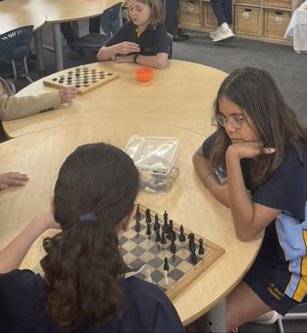
Friendships &
Social Skills
Middle Childhood 6-8
  Show more independence from parents and family.
  Start to think about the future.
  Understand more about his or her place in the world.
  Pay more attention to friendships and teamwork.
  Want to be liked and accepted by friends.
Notes:
Middle childhood brings many changes in a child’s life. By this time, children can dress themselves, catch a ball more easily and tie their shoes. Having independence from their family becomes more important now. Friendships become more and more important. Physical, social, and mental skills develop quickly at this time also. This is a critical time for children to develop confidence in all areas of life, including friendships, schoolwork, and sports.

Slide 16
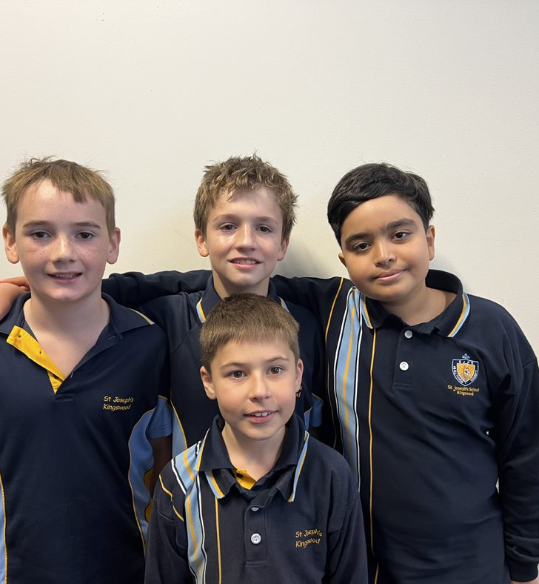
Friendships &
Social Skills
Middle Childhood 9 - 11
Children in this age group might:
  Start to form stronger, more complex friendships and peer relationships. It becomes more emotionally important to have friends, especially of the same sex.
  Experience more peer pressure.
  Become more aware of his or her body as puberty approaches. Body image and eating problems sometimes start around this age.
Notes:
This is why at this age you may begin to hear about friendship issues occurring at school. This is very common because at this age their peer group becomes extremely important to them. children have moved out of the Egocentric stage which is where the child assumes that other people see, hear, and feel exactly the same as they do into the middle childhood stage.

Slide 17
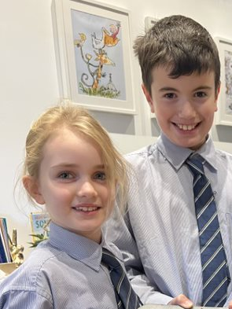
Social Skills
Program
  learning to cooperate
  taking turns and being fair
  sharing
  listening to one other
  showing empathy and being sympathetic to each other’s feelings
  managing conflict
Notes:
We cannot assume that children have the skills to navigate this next stage of development so at St Joseph's we are introducing our Social Skills program. This is where we will be explicitly teaching children how to navigate through some of the typical issues that arise

Slide 18
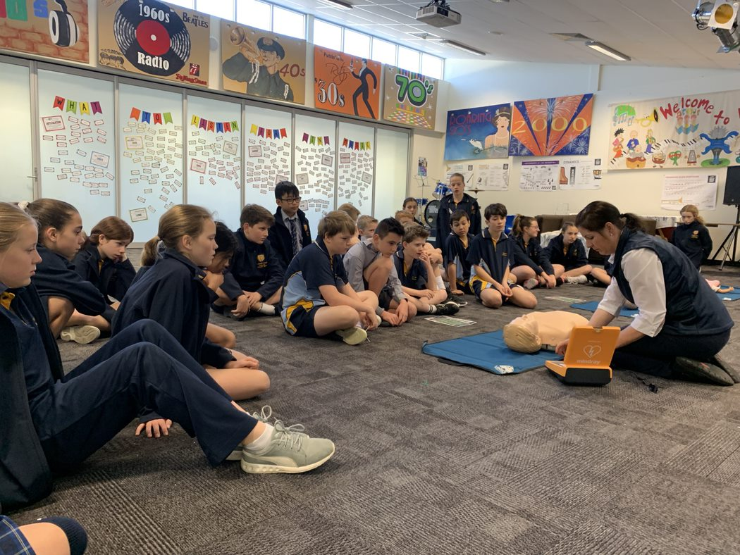
Term 1 - Connections
Welcome, belonging, leadership, community, making friends
Term 2 - In all things Charity
Empathy, compassion, kindess, mindfullness, resillence
Overview
Term 3 - Respect
Integrity, justice
Term 4- Gratitude
Composure
Notes:
Each term our social skills program will have a different focus that will also align to our school values and our school motto - In All Things Charity.

